Slide 1


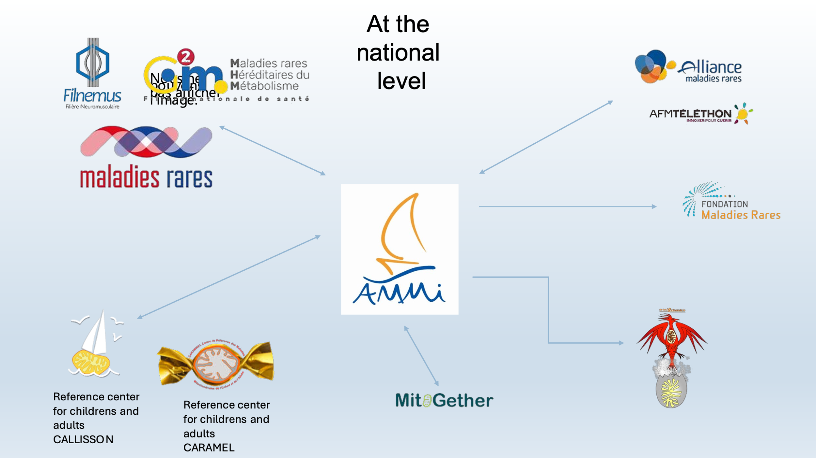


Association contre les Maladies Mitochondriales (A.M.Mi)
Authors / organisation
Intro
Impact
. Founded in 1998, AMMi (Association against mitochondrial diseases) is a French patient organisation dedicated to all mitochondrial diseases, regardless of genetic origin or clinical presentation.
.
Improved visibility of mitochondrial diseases at national, European and international levels
Strengthened collaboration between patients, clinicians, and researchers
Increased integration of patient perspectives in research and healthcare policies
This positioning enables AMMi to contribute to global coordination of research, patient representation, and policy advocacy.
Assoaciation-ammi.org
What is the poster telling us?
Reserch
This poster highlights AMMi’s role as a key stakeholder in the mitochondrial disease ecosystem, presenting its actions in patient support, research advocacy, and international collaboration.
A.M.Mi’s mission
National level
Support and empower patients and families affected by mitochondrial diseases
Promote awareness among healthcare professionals and the general public
Advocate for improved diagnosis, care pathways, and access to treatment
Support and stimulate scientific and clinical research
AMMi’s members
Key actions
European and international level
Organisation of patient meetings, conferences, and awareness campaigns
Dissemination of validated medical and scientific information
Collaboration with clinicians, researchers, and reference centres
Participation in research projects and clinical initiatives
Representation of patients in national and international networks
Conclusion
As a national organisation dedicated to all mitochondrial diseases, AMMi plays a critical role in bridging patients, clinicians, and researchers.
Through its strong involvement in international networks and advocacy initiatives, AMMi contributes to accelerating research, improving patient care, and fostering global collaboration in the field of mitochondrial medicine.

